Slide 1
Chapter 8
Virtual Memory

Slide 2
Virtual Memory Terminology
Virtual memory
A storage allocation scheme in which secondary memory can be addressed as though it were part of main memory.
The size of virtual storage is limited by the addressing scheme of the computer system and by the amount of secondary memory available

Slide 3
Virtual Memory Terminology
Virtual address
The address assigned to a location in virtual memory to allow that location to be accessed as though it were part of main memory.
Virtual address space
The virtual storage assigned to a process.
Address space
The range of memory addresses available to a process.

Slide 4
Virtual Memory Terminology
Real address
The address of a storage location in main memory.

Slide 5
Virtual Memory Terminology
Two characteristics of paging and segmentation
all memory references are logical addresses that are dynamically translated into physical addresses at run time – a process may be swapped in and out of main memory
a process may be broken up into a number of pieces that don’t need to be contiguously located in main memory during execution

Slide 6
Virtual Memory Terminology
If the two characteristics are present, it is not necessary that all of the pages or segments of a process be in main memory during execution

Slide 7
Process Execution
OS brings a few pieces of the program into main memory
Portion of a process that is in main memory is called Resident Set
An interrupt is generated when an address needed that is not in main memory – memory access fault
OS places the process in a blocking state

Slide 8
Process Execution
Piece of process that contains the logical address is brought into main memory
OS issues a disk I/O Read request
Another process is dispatched to run while the disk I/O takes place
An interrupt is issued when disk I/O is complete, which causes the OS to place the affected process in the Ready state

Slide 9
Advantages of Breaking up a Process
More processes may be maintained in main memory
Only load in some of the pieces of each process
With so many processes in main memory, it is very likely a process will be in the Ready state at any particular time
A process may be larger than all of main memory

Slide 10
Types of Memory
Real memory
Main memory (RAM)
Virtual memory
Memory on disk
Allows for effective multiprogramming and relieves the user of tight constraints of main memory

Slide 11
Principle of Locality
Program and data references within a process tend to cluster
Assume that only a few pieces of a process will be needed over a short period of time
Possible to make intelligent guesses about which pieces will be needed in the future – avoid thrashing

Slide 12
Support Needed for Virtual Memory
Hardware must support paging and segmentation
OS must be able to management the movement of pages and/or segments between secondary memory and main memory

Slide 13
Virtual Memory
2 basic approaches:
Paging
Segmentation

Slide 14
Paging
Partition memory into small equal fixed-size chunks
The chunks are called pages
Divide each process into the same size chunks
The chunks are called frames

Slide 15
Paging
OS maintains a page table for each process
Contains the frame location for each page in the process
Memory address (logical address) consist of a page number and offset within the page

Slide 16
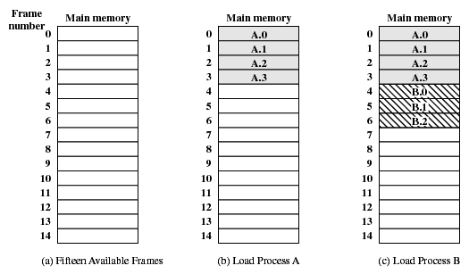
Assignment of Process Pages to Free Frames

Slide 17
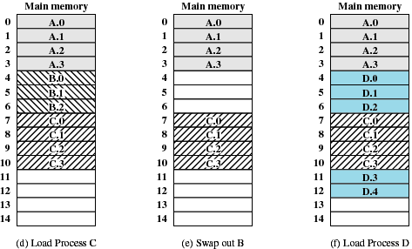
Assignment of Process Pages to Free Frames

Slide 18
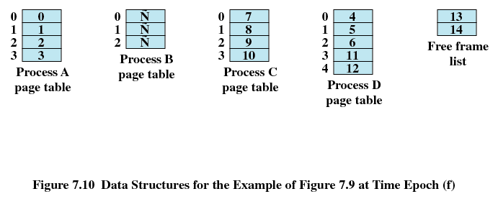
Page Tables for Example
-
-
-

Slide 19
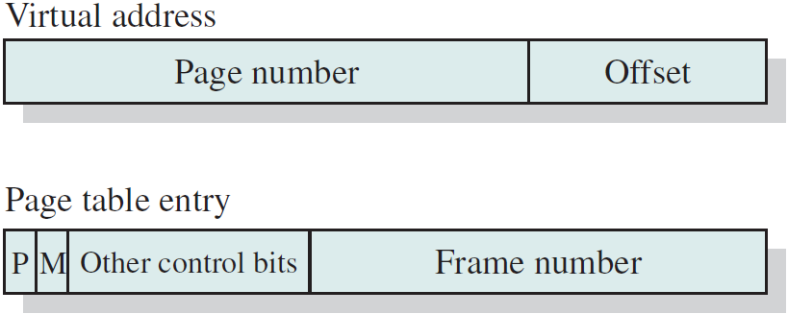
Paging
Each process has its own page table
Each page table entry contains the frame number of the corresponding page in main memory
A bit is needed to indicate whether the page is in main memory or not

Slide 20
Modify Bit in Page Table
Modify bit is needed to indicate if the page has been altered since it was last loaded into main memory
If no change has been made, the page does not have to be written to the disk when it needs to be swapped out

Slide 21
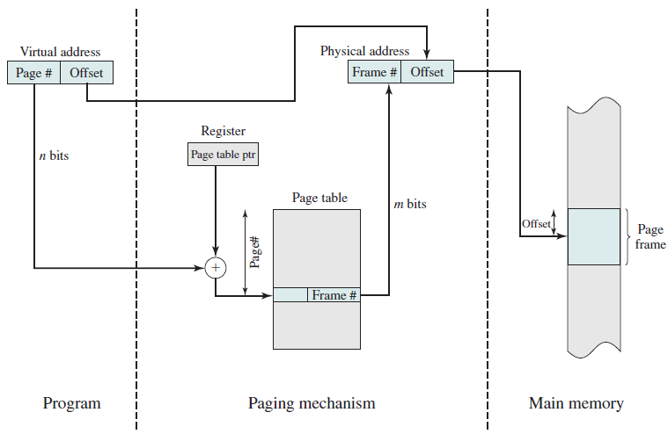
Paging – Address Translation

Slide 22
Paging
A register holds the starting address of the page table for a running process
The page number of virtual address is used to look up the corresponding frame number
The frame number is combined with the offset to produce the real address

Slide 23
Page Tables
The entire page table may take up too much main memory
Page tables are also stored in virtual memory
When a process is running, part of its page table is in main memory
Some processors use two-level scheme to organise large page table

Slide 24
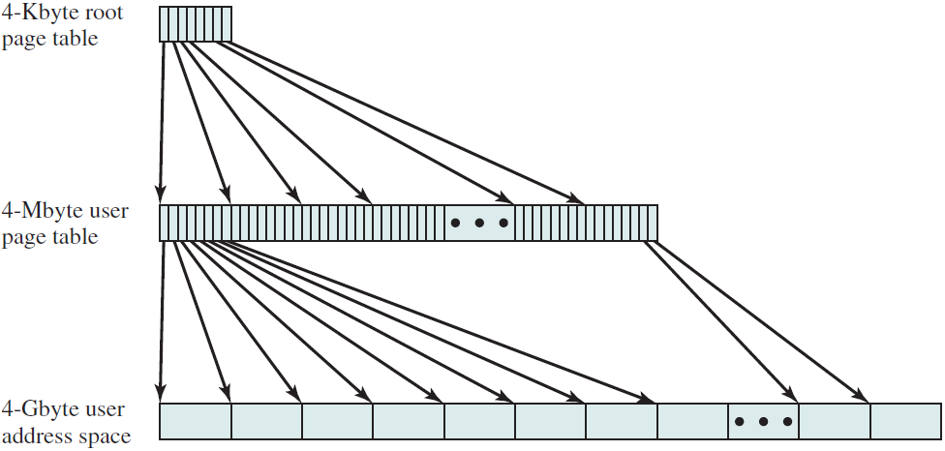
Two-Level Scheme for 32-bit Address
1024 PTEs, each PTE 4 bytes
Total = 4KB
2²⁰ (1M) PTEs, occupying 1024 pages
2²⁰ (1M) pages. Each page is 4KB

Slide 25
Two-Level Scheme
The root page always in the main memory
First 10 bits of a virtual address index into the root page to find a page table entry (PTE) for a page of the user page table
If that page is not in main memory → page fault
The next 10 bits are index into the user PTE page to find the PTE for the page referenced by the virtual address

Slide 26
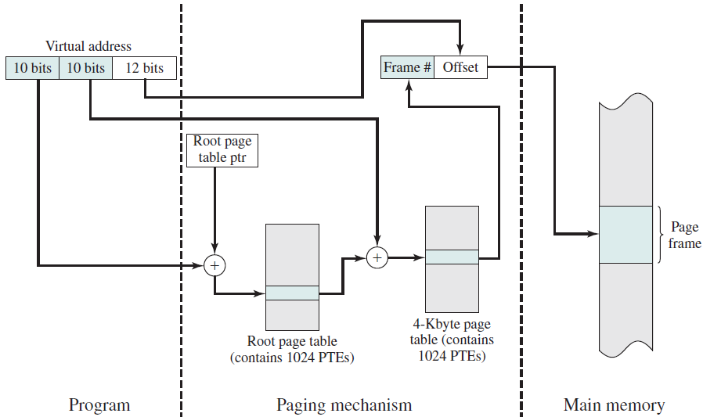
Two-Level Scheme for 32-bit Address

Slide 27
Two-Level Scheme for 32-bit Address
0000000110 | 0000000011 | 000000001100
6
3
12
Frame
No.
Page
No.
0
0
0
0
0
1
1
1
Frame no.
2
Frame no.
2
2
3
3
3
7
3
4
4
4
1024
PTEs
5
5
5
6147
6
6
4
6
7
7
7
8
8
8
1023
Main memory
Root page table
User page table
User
process

Slide 28
Inverted Page Table
There is one entry for each real memory page frame rather than one per virtual page.
Fixed proportion of real memory is required for the tables regardless of the number of processes / virtual pages
Page number portion of a virtual address is mapped into a hash value.
Hash value points to inverted page table.

Slide 29
Inverted Page Table
Each entry in page table includes
Page number
Process identifier – the process that owns this page
Control bits – includes flags and protection and locking information
Chain pointer – the index value of the next entry in the chain

Slide 30
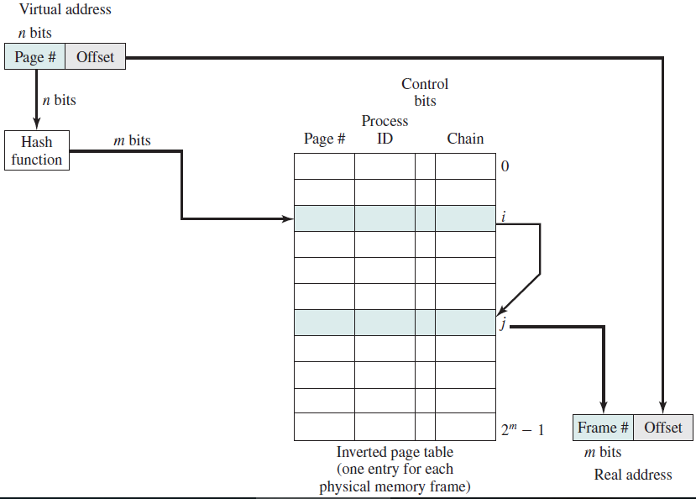
Inverted Page Table

Slide 31
Translation Lookaside Buffer
Each virtual memory reference can cause two physical memory accesses
One to fetch the page table
One to fetch the data
Memory access time is doubled

Slide 32
Translation Lookaside Buffer
To overcome this problem a high-speed cache is set up for page table entries, called a Translation Lookaside Buffer (TLB)
Contains page table entries that have been most recently used
Given a virtual address, processor examines the TLB
If page table entry is present (TLB hit), the frame number is retrieved and the real address is formed

Slide 33
Translation Lookaside Buffer
If page table entry is not found in the TLB (TLB miss), the page number is used to index the process page table
First checks if page is already in main memory
If not in main memory a page fault is issued
The TLB is updated to include the new page entry

Slide 34
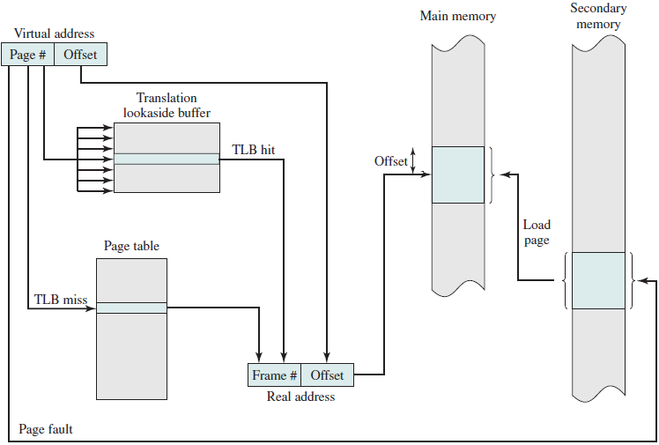
Translation Lookaside Buffer

Slide 35
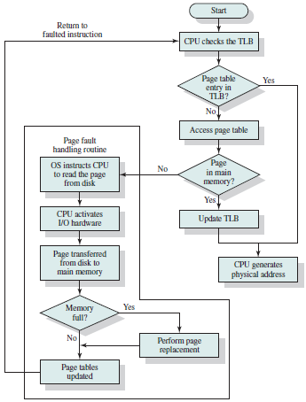
Translation Lookaside Buffer

Slide 36
Translation Lookaside Buffer
TLB contains only some entries in a full page table, cannot simply index to TLB based on the page number
each entry must include the page number and the complete page table entry → associative mapping (allows processor to interrogate simultaneously a number of TLB entries to determine if there is a match on page number)

Slide 37
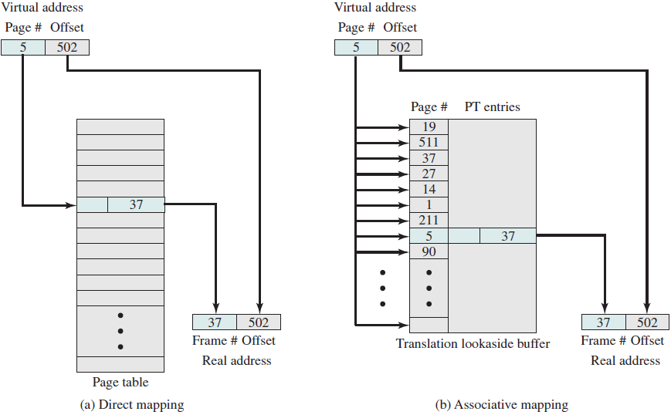
Translation Lookaside Buffer

Slide 38
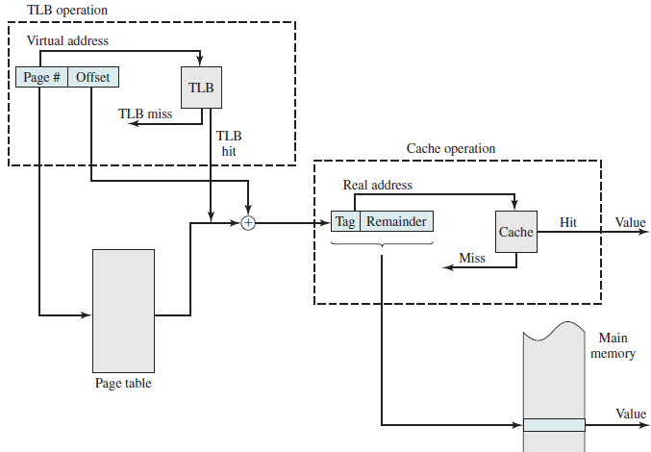
Translation Lookaside Buffer

Slide 39
Page Size
Smaller page size
less amount of internal fragmentation → optimize the use of main memory
more pages required per process → means larger page tables → means large portion of page tables in virtual memory
Might be a double page fault for a single reference:
Bring in the needed portion of the page table
Bring in the process page

Slide 40
Page Size
Secondary memory is designed to efficiently transfer large blocks of data so a large page size is better

Slide 41
Page Size
Small page size, large number of pages will be found in main memory
As time goes on during execution, the pages in memory will all contain portions of the process near recent references. Page faults low.
Increased page size causes pages to contain locations further from any recent reference. Page faults rise.

Slide 42
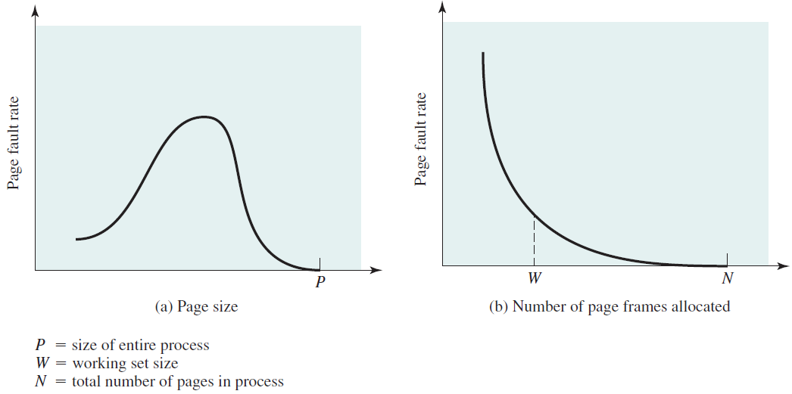
Page Size

Slide 43
Example Page Sizes
Computer | Page Size
Atlas | 512 48-bit words
Honeywell-Multics | 1024 36-bit words
IBM 370/XA and 370/ESA | 4 Kbytes
VAX family | 512 bytes
IBM AS/400 | 512 bytes
DEC Alpha | 8 Kbytes
MIPS | 4 Kbytes to 16 Mbytes
UltraSPARC | 8 Kbytes to 4 Mbytes
Pentium | 4 Kbytes or 4 Mbytes
IBM POWER | 4 Kbytes
Itanium | 4 Kbytes to 256 Mbytes

Slide 44
Segmentation
Program and its associated data are divided into segments
All segments of all programs do not have to be of the same length, but there is a maximum segment length
Addressing consist of two parts - a segment number and an offset

Slide 45
Segmentation
Since segments are not equal, segmentation is similar to dynamic partitioning, but a program may occupy more than one partition that need not to be contiguous

Slide 46
Segment Tables
Each entry contains
starting address of corresponding segment in main memory
the length of the segment
Only some of the segments in main memory
A bit is needed to determine if segment is already in main memory
Another bit is needed to determine if the segment has been modified since it was loaded in main memory

Slide 47
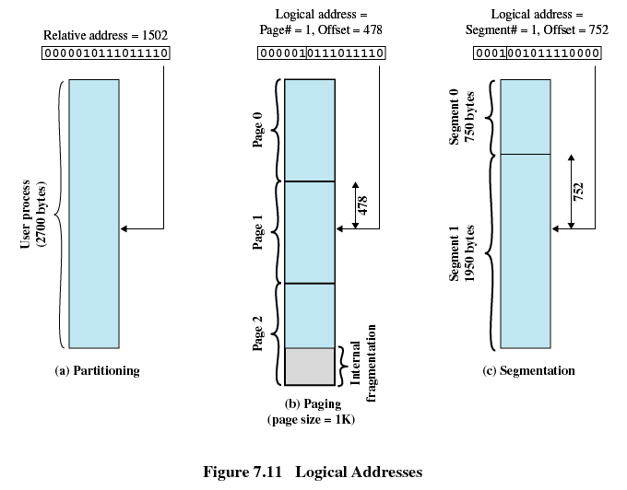
Segmentation

Slide 48
Segmentation
Address translation:
Extract the segment number from logical address
Use the segment number to find the starting physical address of the segment
Compare the offset to the length of the segment, if the offset is greater than or equal to the length, the address is invalid
The physical address is the sum of the segment starting physical address plus the offset

Slide 49
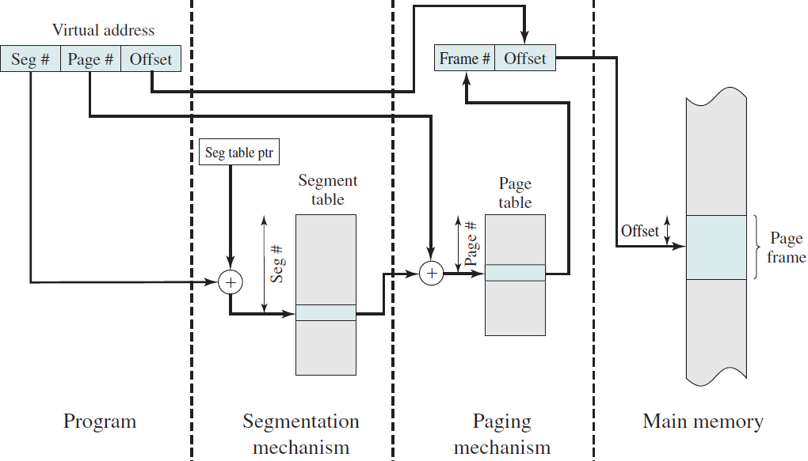
Segmentation

Slide 50
Segmentation
Advantages to programmer:
Simplifies handling of growing data structures → operating system will expand or shrink the segment as needed
Allows programs to be altered and recompiled independently
Lends itself to sharing data / procedures among processes
Lends itself to protection → assign access privileges

Slide 51
Combined Paging and Segmentation
User’s address space is broken up into a number of segments
Each segment is broken into fixed-size pages

Slide 52
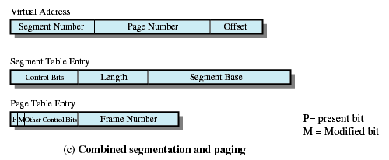
Combined Segmentation and Paging
Refer to a page table

Slide 53
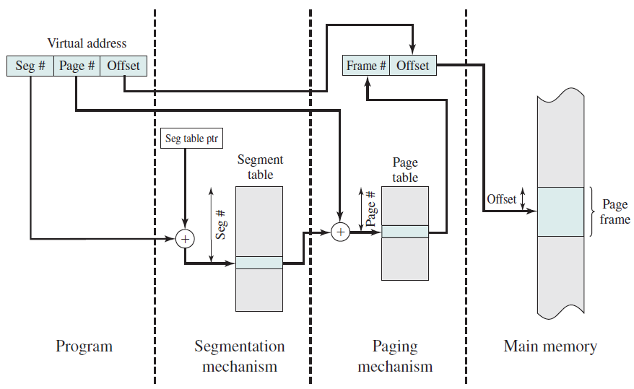
Combined Segmentation and Paging

Slide 54
Thrashing
Swapping out a piece of a process just before that piece is needed
The processor spends most of its time swapping pieces rather than executing user instructions

Slide 55
OS Policies for Virtual Memory
Fetch policy
Placement policy
Replacement policy
Resident set management
Cleaning policy
Load control

Slide 56
Fetch Policy
Determines when a page should be brought into memory
Two common alternatives:
Demand paging only brings pages into main memory when a reference is made to a location on the page
Many page faults when process first started
Prepaging brings in more pages than needed
More efficient to bring in pages that reside contiguously on the disk (due to the seek times and rotational latency)

Slide 57
Replacement Policy
Which page is replaced?
Page removed should be the page least likely to be referenced in the near future
Most policies predict the future behavior on the basis of past behavior

Slide 58
Replacement Policy
Restriction → Frame Locking
If frame is locked, it may not be replaced
Locked frames holding
Kernel of the operating system
Control structures
I/O buffers
Associate a lock bit with each frame

Slide 59
Basic Replacement Algorithms
Optimal policy
Least recently used (LRU) policy
First-in-first-out (FIFO) policy
Clock policy

Slide 60
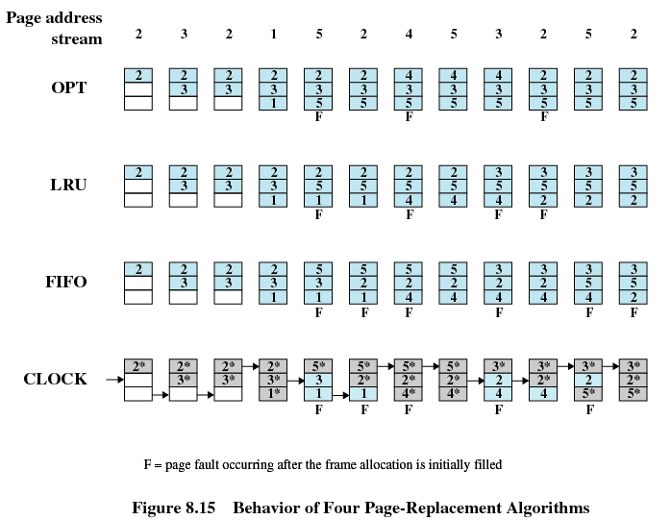
Basic Replacement Algorithms
Optimal policy
Selects for replacement that page for which the time to the next reference is the longest
Impossible to have perfect knowledge of future events

Slide 61
Basic Replacement Algorithms
Least Recently Used (LRU)
Replaces the page that has not been referenced for the longest time
By the principle of locality, this should be the page least likely to be referenced in the near future
Each page could be tagged with the time of last reference. This would require a great deal of overhead.

Slide 62
Basic Replacement Algorithms

Slide 63
Basic Replacement Algorithms
First-in, first-out (FIFO)
Treats page frames allocated to a process as a circular buffer
Pages are removed in round-robin style
Simplest replacement policy to implement
Page that has been in memory the longest is replaced
These pages may be needed again very soon

Slide 64
Basic Replacement Algorithms

Slide 65
Basic Replacement Algorithms
Clock Policy
Associate an additional bit called a use bit with each frame
When a page is first loaded in memory, the use bit is set to 1
When the page is referenced, the use bit is set to 1
When it is time to replace a page, the first frame encountered with the use bit set to 0 is replaced.

Slide 66
Basic Replacement Algorithms
Clock Policy
During the search for replacement, each use bit set to 1 is changed to 0

Slide 67
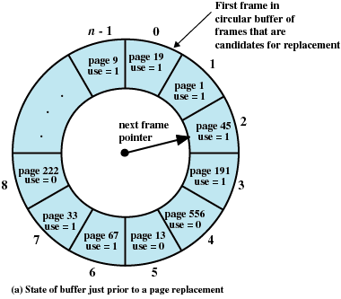
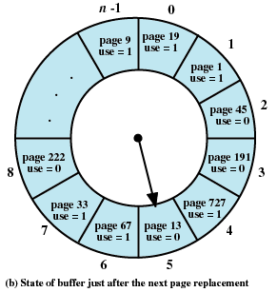
Basic Replacement Algorithms
Example: incoming page - 727

Slide 68
Basic Replacement Algorithms
Asterisk: use bit is set to 1
Arrow: current position of pointer

Slide 69
Resident Set Size
How many pages to bring in?
How much memory to allocate to a process?
Two policies:
Fixed-allocation
Gives a process a fixed number of pages within which to execute
When a page fault occurs, one of the pages of that process must be replaced

Slide 70
Resident Set Size
Two policies:
Variable-allocation
Number of pages allocated to a process varies over the lifetime of the process (if page faults level is high, additional page frames will be given)

Slide 71
Replacement Scope
Local replacement policy: a page in the resident pages of the process that generated the page fault is selected to replace
Global replacement policy: all unblocked pages are considered as candidates to replace
Fixed-allocation: employ local replacement policy
Variable-allocation: can employ both local and global replacement policies

Slide 72
Fixed Allocation, Local Scope
Decide ahead of time the amount of allocation to give a process
Drawbacks:
If allocation is too small, there will be a high page fault rate
If allocation is too large there will be too few programs in main memory

Slide 73
Variable Allocation, Global Scope
Easiest to implement
Adopted by many operating systems
Operating system keeps list of free frames
Free frame is added to resident set of process when a page fault occurs
If no free frame, replaces one from another process

Slide 74
Variable Allocation, Local Scope
When new process added, allocate number of page frames based on application type, program request, or other criteria
When page fault occurs, select page from among the resident set of the process that suffers the fault
Reevaluate allocation from time to time, increase / decrease the allocation as needed

Slide 75
Variable Allocation, Local Scope
Decision to increase or decrease a resident set size is based on the assessment of the likely future demands of active processes – more complex but better performance

Slide 76
Cleaning Policy
Opposite of the fetch policy, determine when a modified page should be written out to secondary memory
Demand cleaning
A page is written out only when it has been selected for replacement
Precleaning
Pages are written out in batches, before their frames are needed

Slide 77
Cleaning Policy
Best approach uses page buffering
Replaced pages are placed in two lists
Modified and unmodified
Pages in the modified list are periodically written out in batches
Pages in the unmodified list are either reclaimed if referenced again or lost when its frame is assigned to another page

Slide 78
Load Control
Determines the number of processes that will be resident in main memory (multiprogramming level)
Too few processes, many occasions when all processes will be blocked and much time will be spent in swapping
Too many processes will lead to thrashing

Slide 79
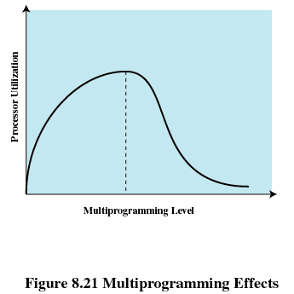
Multiprogramming

Slide 80
Process Suspension
Lowest priority process
Faulting process
This process does not have its working set in main memory so it will be blocked anyway
Last process activated
This process is least likely to have its working set resident

Slide 81
Process Suspension
Process with smallest resident set
This process requires the least future effort to reload
Largest process
Obtains the most free frames
Process with the largest remaining execution window

Slide 82
Linux Memory Management
3-level page table (size of 1 page)
Page directory
Reside in main memory
Each entry points to 1 page of page middle directory
Page middle directory
Each entry points to 1 page of page table
Page table
Virtual address consisting of 4 fields

Slide 83
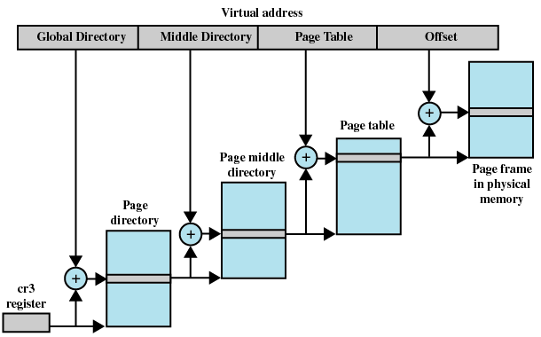
Linux Memory Management

Slide 84
Linux Memory Management
Contiguous blocks of pages are mapped into contiguous blocks of frames by using buddy system
Kernel maintains a list of contiguous frame groups (a group may consist 1, 2, 4, 8, 16 or 32 frames)

Slide 85
Linux Memory Management
Using clock replacement algorithm, but the use bit is replaced with an age variable
Age variable is incremented on every access
Linux periodically decrements the age variable
Page with age variable equal to zero can be replaced

